Slide 1
Movie Recommendation Data Analysis
Name: Pallavi Borde

Slide 2
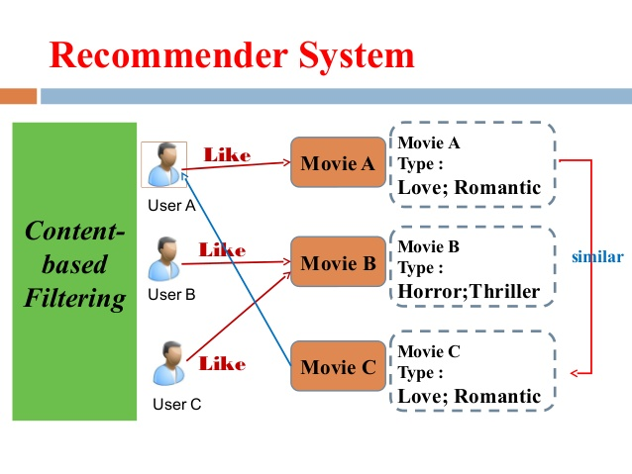
What?
User entered data
Analysis
Recommendation

Slide 3
Attributes
Movie title, director name, number of critic reviews, year of release, number of facebook likes, actor names, genres, language, country, imdb score, etc
Total 72 attributes
Used: Movie title, critic reviews, year of release, country, genres, imdb rating, etc.
Total used: 7

Slide 4

Pre-processing
Missing values
Bad data
Duplicates

Slide 5
Analysis Functions
Top 10 movies on the basis of rating
Most watched genre in a country
Comparison of critic reviews for a movie entered with 5 movies having highest critic reviews
Number of movies released in a year

Slide 6
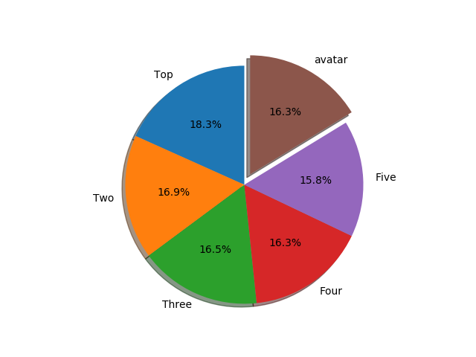
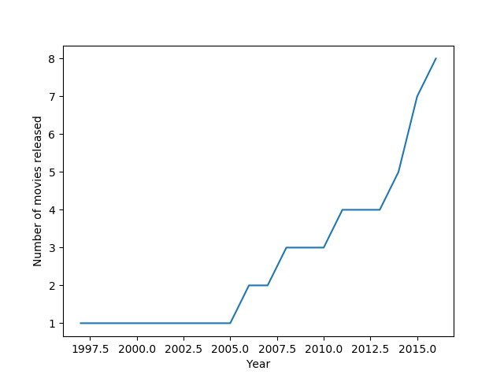
Graph
Comparison on the basis of critic reviews:
Number of movies released every year:

Slide 7
Thank you!
Questions?

